Slide 1


Job Market Trends and Forecasting Methods
NEXT HIKES IT SOLUTIONS
Project 8
25/10/2026
Monalisha Das

Slide 2
Agenda
Introduction and Project Overview
Methodology and Data Preparation
Market Analysis
Forecasting Approach
Forecasting Results and Interpretation
Market Trends and Practical Implications
02

Slide 3



Why This Study Matters
Job markets shift fast
Technology changes and platform demand create quick role turnover.
Remote-first marketplaces amplify these shifts and new niches.
Turning postings into insight
We translate job-posting signals into trends people can act on.
Find what’s in demand, where demand comes from, and pay signals.
From analysis to forecasts
Use short-horizon forecasts to anticipate next-week demand patterns.
Support decisions with recommendations that match users to postings.
Introduction and Project Overview
03

Slide 4



Project Goal
Market insights from postings
Track demand signals, pay patterns, and where clients post work.
Summarize activity by role groups when titles are too fragmented.
Short-horizon demand forecasting
Estimate which role families will be busiest in the next days.
Use time-ordered testing so forecasts reflect real future use.
Personalized job matching
Recommend current postings by matching a user’s role and skills.
Apply filters only on fields the dataset actually contains.
Introduction and Project Overview
04

Slide 5
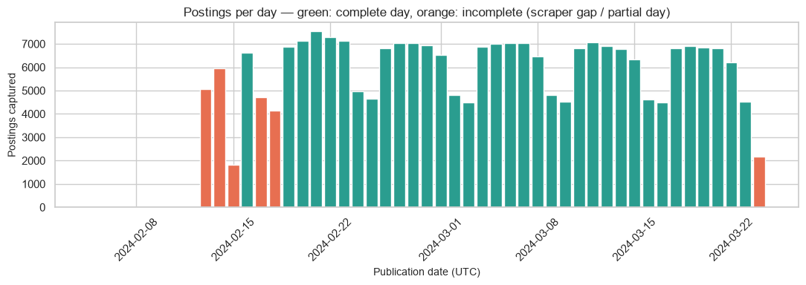
What Data Was Used
Dataset snapshot
We analyzed 244,291 cleaned freelance job postings from Upwork.
Each record includes title, date, pay type/amounts, and client country.
Reliable time window
Trend and forecast work used a 34-day run of fully captured days.
This “core window” spans 19 Feb to 23 Mar 2024 (UTC).
Why this matters
Using only complete days avoids mistaking scraper gaps for demand changes.
Introduction and Project Overview
05

Slide 6



What The Data Can Show
What this dataset supports
It measures where posting demand is concentrated and how it cycles by weekday.
It compares advertised pay patterns across categories and client countries.
What it can suggest (carefully)
It can flag short-term movers in category share within the 34-day complete window.
It can highlight rising title keywords as early, candidate trend signals.
What it cannot credibly claim
It cannot support strong long-range forecasts from only about five reliable weeks.
It cannot infer work location, company, skills, or true remote-versus-onsite shifts.
Introduction and Project Overview
06

Slide 7
How The Study Was Built
01
02
03
Notebook 1: Data foundation
Loaded raw postings, validated fields, and created a clean, reusable dataset.
Explored demand, pay patterns, geography, and weak remote-work signals from titles.
Notebook 2: Forecasting + recommendations
Built short-horizon demand forecasts, comparing baseline and alternative models fairly.
Created a TF-IDF title-matching recommendation engine with transparent ranking logic.
Notebook 3: Monitoring + deployment
Turned outputs into a monthly report and Plotly dashboard for ongoing tracking.
Delivered a Flask API setup to run the recommender consistently.
Methodology and Data Preparation
07

Slide 8



Cleaning Before Forecasting
Removing noise before analysis
Duplicate postings were dropped to avoid double-counting demand.
Posts without titles were removed because they cannot be categorized.
Standardizing key fields
Client countries were cleaned and mapped consistently for comparisons.
Hourly and fixed-price pay were standardized and kept separate.
Using only trustworthy time windows
Trends and forecasts used complete days to avoid scraper-gap bias.
The “core window” isolates continuous coverage for fair week-to-week signals.
Methodology and Data Preparation
08

Slide 9
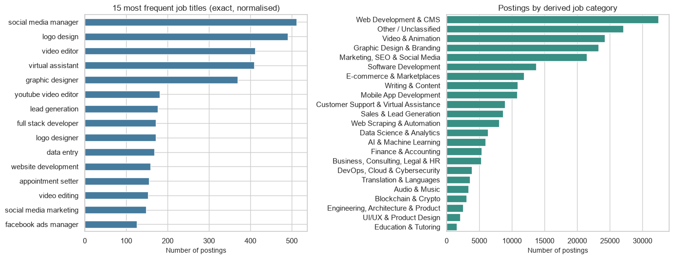

What The Market Looks Like
Demand concentrates in a few families
Most postings cluster around web/CMS, video, design, and marketing work.
These are service-heavy, digital roles suited to freelance marketplaces.
Titles are highly fragmented
There are over 200k distinct normalized titles across 244k postings.
Exact-title “top lists” are therefore noisy and not very stable.
Using categories to see trends
Keyword-derived categories combine similar roles into clearer trend signals.
This makes demand tracking more reliable than comparing specific titles.
Market Analysis
09

Slide 10
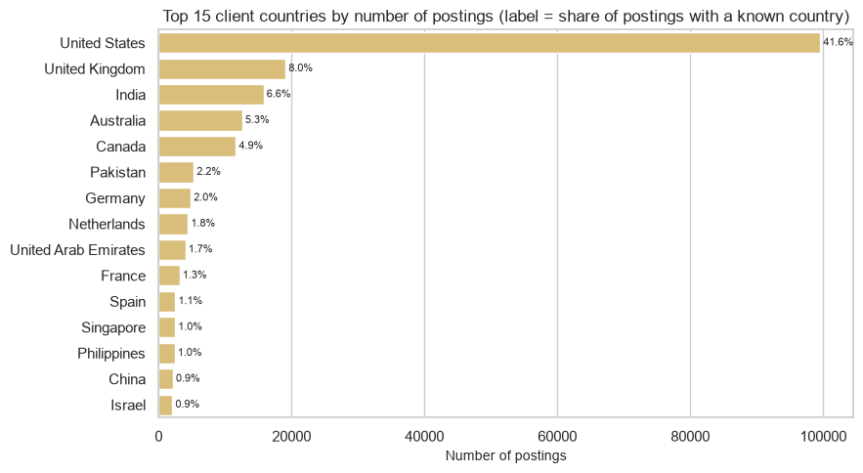
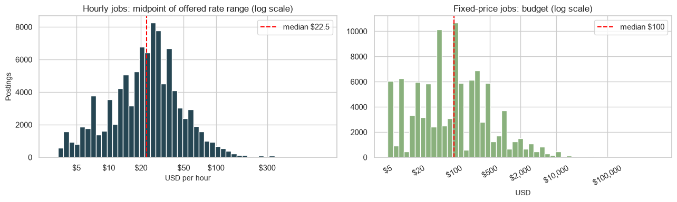
Key Market Signals
Where demand comes from
The United States accounts for about 42% of postings with a known client country.
Posting activity spans 200+ client countries, but volume is concentrated in a few.
Typical pay signals (offers)
For hourly jobs that disclose rates, the median offer is $22.5 per hour.
For fixed-price jobs, the median posted budget is $100 per project.
What this implies about the market
Most volume sits in digital freelance work, especially development and creative services.
Market Analysis
10

Slide 11
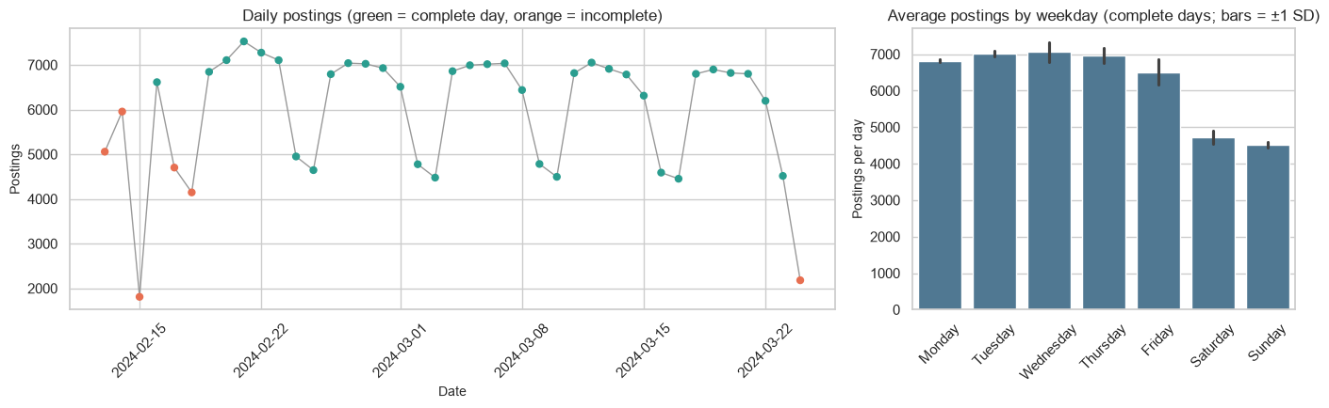
Weekly Rhythm Matters
A repeating weekly pattern
Posting counts rise and fall by weekday, more than by long-run trend.
This weekly seasonality is the clearest, most reliable signal in the data.
Weekends are consistently quieter
Weekend posting volume is about 33% lower than the weekday average.
That predictable dip should be treated as “normal,” not a slowdown shock.
Forecasting implication
Any short-term forecast should explicitly include weekdays to avoid bias.
Simple “same weekday as last week” baselines are strong when data is short.
Market Analysis
11

Slide 12
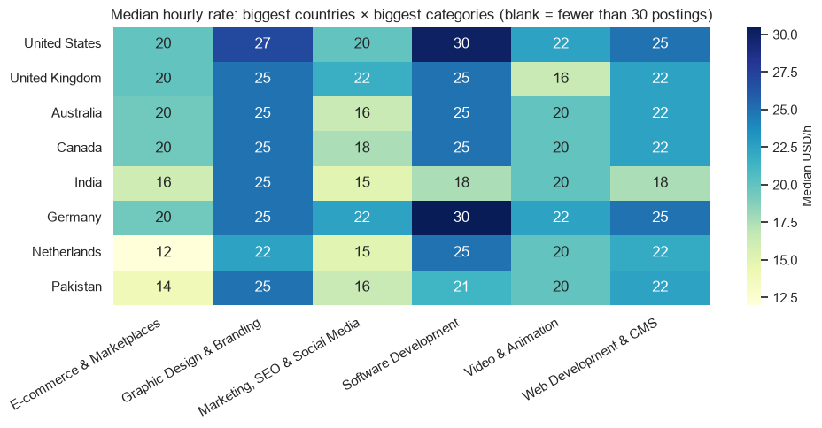
High Demand Categories
Who drives demand
The busiest role families were Web Development, Video, Design, and Marketing.
These groups consistently led daily posting counts in the training window.
Why they matter for forecasts
Large, steady categories are easier to forecast than niche roles.
Their day-to-day movement mostly follows the weekly work cycle.
How they were selected
High-demand roles were defined as the top categories by average daily postings.
The ranking used training days only to avoid leaking test-period information.
Market Analysis
12

Slide 13
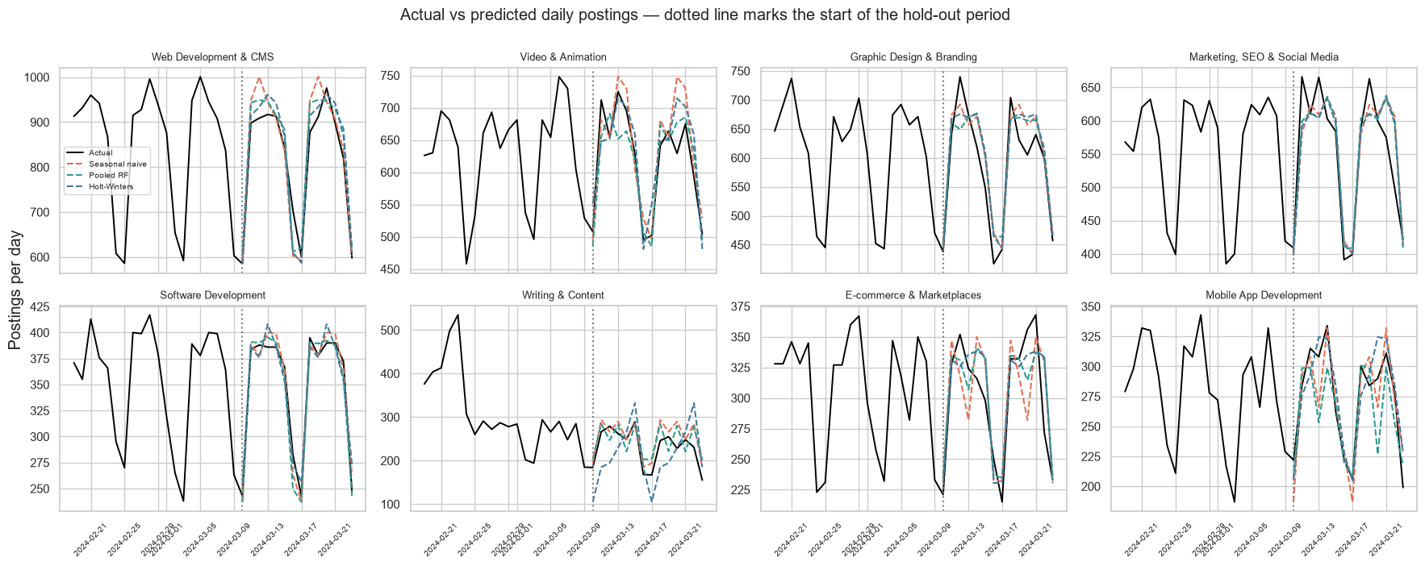
Forecasting Challenge
Short history limits what forecasting can learn
Only 20 training days existed before the 14-day holdout period.
This captures weekly repetition, but not longer market seasonality.
Model scope was set to match data reality
Forecasts focused on days ahead, not month-ahead hiring narratives.
Evaluation used time-ordered splits to avoid learning from the future.
Forecasting Approach
13

Slide 14
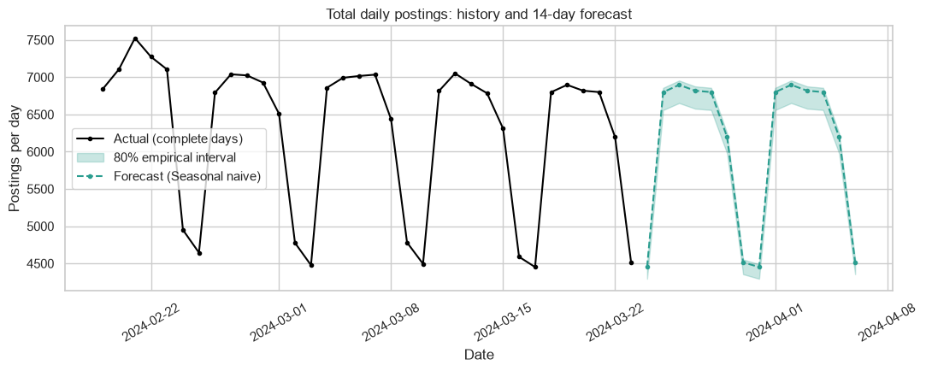
Models Compared
Baseline used for comparison
Seasonal naive repeats last week’s same weekday posting count.
It sets a realistic bar for any “smarter” model.
Alternative forecasting approaches
Holt-Winters smooths overall level plus weekly seasonality.
Damped Holt-Winters adds a trend that fades over time.
Pooled Random Forest uses weekday and recent history features.
Fair, time-aware evaluation
Models trained only on earlier days and tested on later days.
A rolling-origin back test checked stability beyond one split.
Forecasting Approach
14

Slide 15

How Accuracy Was Judged
Metrics used for forecasts
Scoring forecasts using MAE, RMSE, and MAPE on daily posting counts.
These metrics fit numeric counts better than “accuracy” labels meant for classification.
What each metric tells us
MAE shows the typical day-to-day miss in number of postings.
RMSE penalizes larger misses more, so spikes and dips matter.
MAPE expresses error as a percentage, making categories comparable in scale.
Interpreted results
Together, the three metrics balance average error, big surprises, and relative size.
Forecasting Approach
15

Slide 16
Best Model Selected
Selection result
The seasonal naive method had the lowest hold-out error (MAE 29.56).
Validated by backtesting
Rolling-origin backtests also favored the same simple baseline approach.
What this means
With only ~34 complete days, weekly repetition beat heavier models.
Practical takeaway
For short horizons, repeatable weekday patterns are the most reliable signal.
model | MAE | RMSE | MAPE_% | MAE_skill_vs_naive_% | n_forecasts
Holt-Winters | 36.94 | 51.79 | 9.52 | -24.97 | 144
Holt-Winters (damped) | 37.10 | 51.02 | 9.48 | -25.52 | 144
Pooled Random Forest | 32.98 | 40.55 | 7.64 | -11.57 | 144
Seasonal naive | 29.56 | 39.00 | 6.63 | 0.00 | 144
Forecasting Results and Interpretation
16

Slide 17

Why Simple Won
Weekly pattern dominated
Posting counts mainly repeated the same weekday rhythm across weeks.
That left little extra structure for complex models to learn.
Too little history for complexity
Only about 34 complete days were reliable for modelling.
With so few cycles, extra parameters mostly add noise, not insight.
A useful modeling result
Simple seasonal-naive forecasts captured demand as well as alternatives.
This shows model choice should match data reality, not ambition.
Forecasting Results and Interpretation
17

Slide 18

Future Trend Forecast
What was forecast
Projected total job-posting volume for the next 14 days after the last complete day.
The forecast repeats the established weekly cycle rather than assuming new long-term trends.
Expected weekly pattern
Sundays are expected to be lighter, around 4,452 postings per day.
Tuesdays are expected to be busier, around 6,897 postings per day.
How to interpret it
This points to short-term stability in demand, not a major market shift.
With only ~34 reliable days of history, forecasts are best used for near-term planning.
Forecasting Results and Interpretation
18

Slide 19
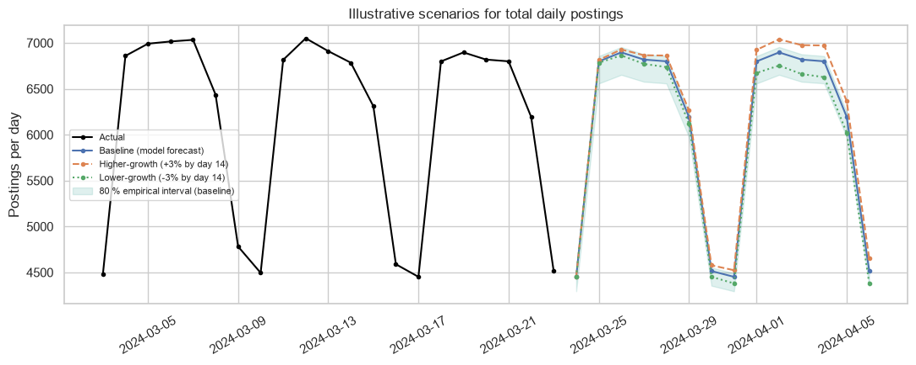
Scenario Thinking
Why scenarios were added
With only ~34 complete days of history, long-run trend signals are limited.
So scenarios complement the baseline by exploring plausible short-term drift.
How the scenarios work
Start from the baseline forecast that repeats the weekly pattern.
Apply a gradual ±3% drift across the 14-day horizon to reflect observed variability.
How to interpret them
Treat scenario outputs as sensitivity bounds, not guaranteed outcomes.
Use them to stress-test plans when volume shifts slightly up or down.
Forecasting Results and Interpretation
19

Slide 20
Broader Market Trends
01
02
03
Early growth signals
Posting-share gains flagged Blockchain & Crypto and AI & Machine Learning as candidates.
These increases reflect more listings, not guaranteed long-term shifts.
Areas losing share
Writing & Content, Translation & Languages, and Virtual Assistance showed the clearest declines.
This means fewer postings relative to the whole market mix.
Why caution is needed
The reliable window is only 4 full weeks, so results are short-horizon signals.
Confirming “emerging” trends requires several months of consistent data.
Market Trends and Practical Implications
20

